Slide 1





WELCOME TO
The SECMUN CLUB

Slide 2

MUN WORKSHOP SERIES DAY 3
SECMUN CLUB | September 25th 2025

Slide 3
MASTERING STRATEGIC RESEARCH
THE BASICS
A methodical pathway from foundational strategy to advanced analysis and content advocacy.

Slide 4
Phase 1: Foundational Strategy
The "Why": Defining Your Research Purpose
Keyword Mapping: Building a Research Roadmap
Connected Research: Synthesizing Information
UN Committees: Represent national interests, aligned with international law. Focus on your country's economic, security, and social well-being.
Treat each keyword as an individual topic, but ensure all research points connect to form a cohesive, compelling narrative.
Identify core terms, key actors, and historical context.
Example: For "Climate Change," search UNFCCC, Paris Agreement, Green Climate Fund, and [Your Country] + climate policy.
Indian Committees: Act as a partisan advocate. Champion the party's official stance and historical ideology.

Slide 5

Phase 2: Deep Dive & Analysis
01
02
Source Evaluation: Beyond the URL
Mastering Google Scholar
Credibility: Verify author expertise and institutional reputation.
Use advanced features for in-depth, peer-reviewed articles.
Bias: Identify political, financial, or ideological agendas.
Use "Cited by" to find newer research.
Recency: Check if the information is current and relevant to the topic.
Use "Related articles" for similar papers.
Use the [PDF] link for direct access to full text.
03
Active Learning: Internalizing Knowledge
Summarize: Condense key takeaways after reading.
Mind Map: Visually connect keywords and concepts.
Teach it: Explain the topic aloud to solidify understanding.

Slide 6
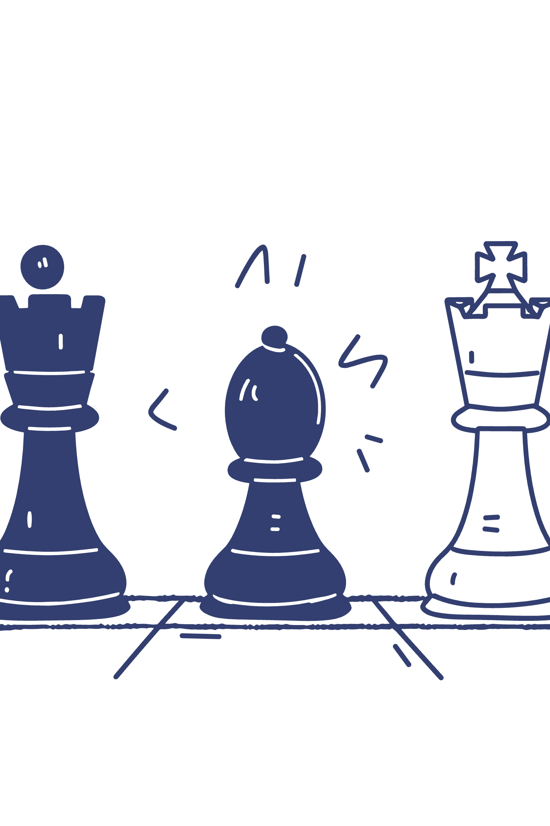
Phase 3: Competitive Strategy
Anticipation: Identifying Your Own Weaknesses
The Strategic Strike: Uncovering Opponent Loopholes
Proactively find potential vulnerabilities in your position.
Look for inconsistencies and hypocrisy in opponents' arguments.
Develop counterarguments and solutions to preemptively defend your stance.
Questions to Ask: Is their policy financially viable? Is their solution historically effective? Do their actions align with their stated stance?

Slide 7
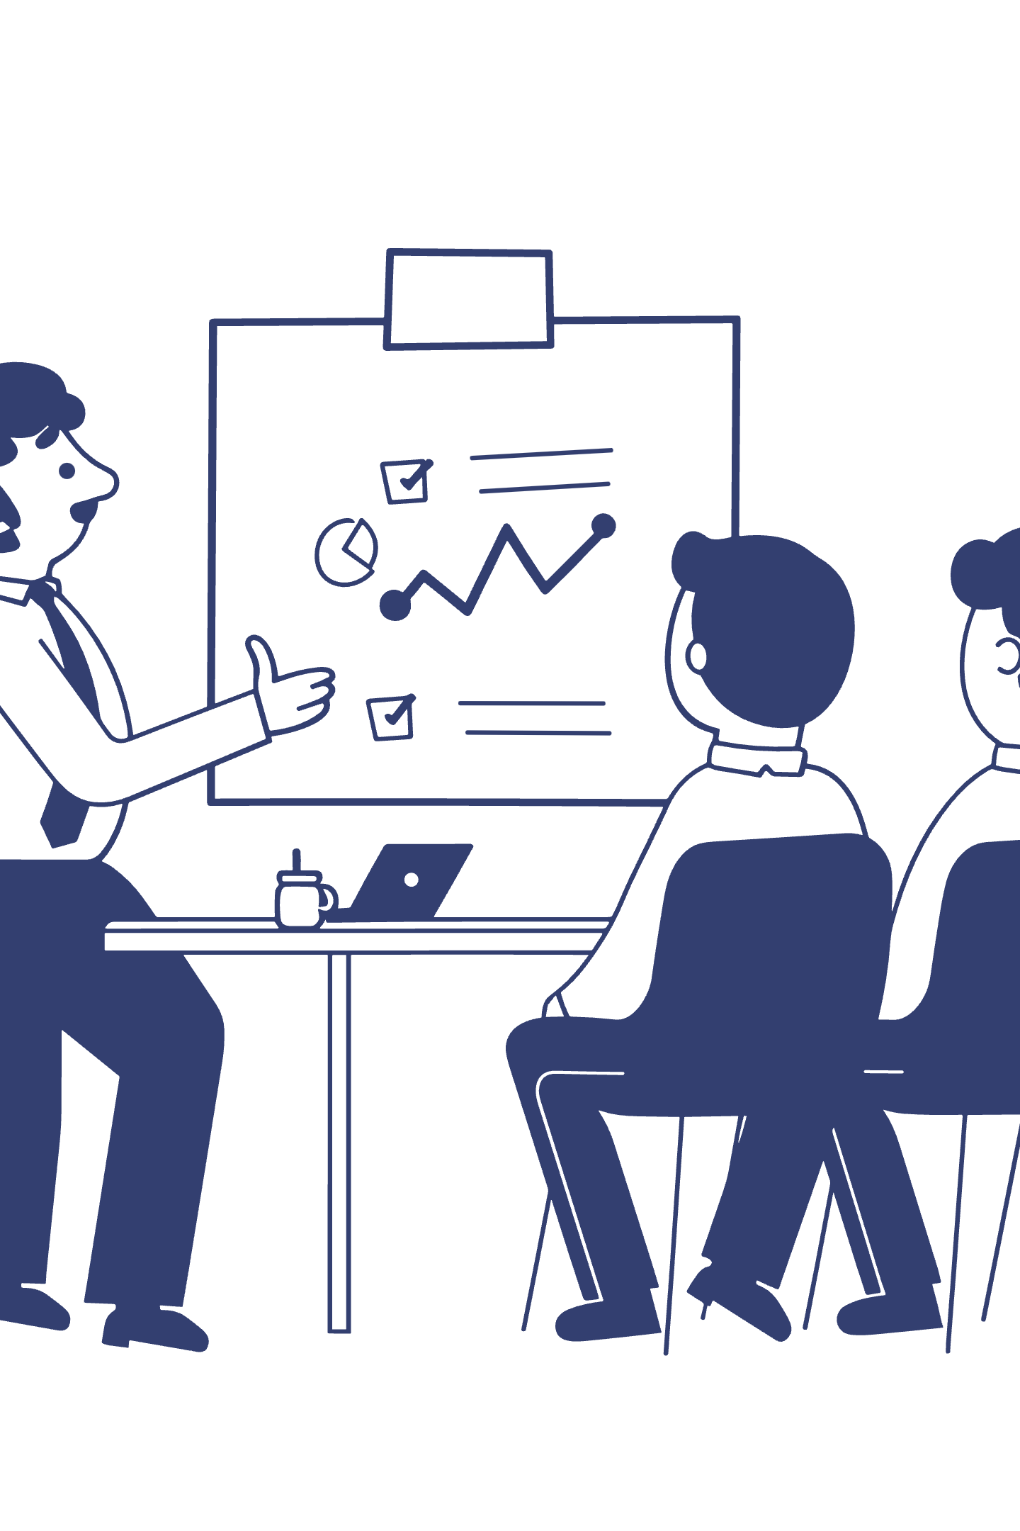
Phase 4: Performance & Role-Playing
UN Committees: The Diplomat
Maintain professionalism, decorum, and carefully chosen language.
Represent your country's interests with seriousness and respect.
Indian Committees: The Partisan Leader
Embody your political party's core ideology.
Respond to challenges with confidence and assertiveness, referencing your research.

Slide 8
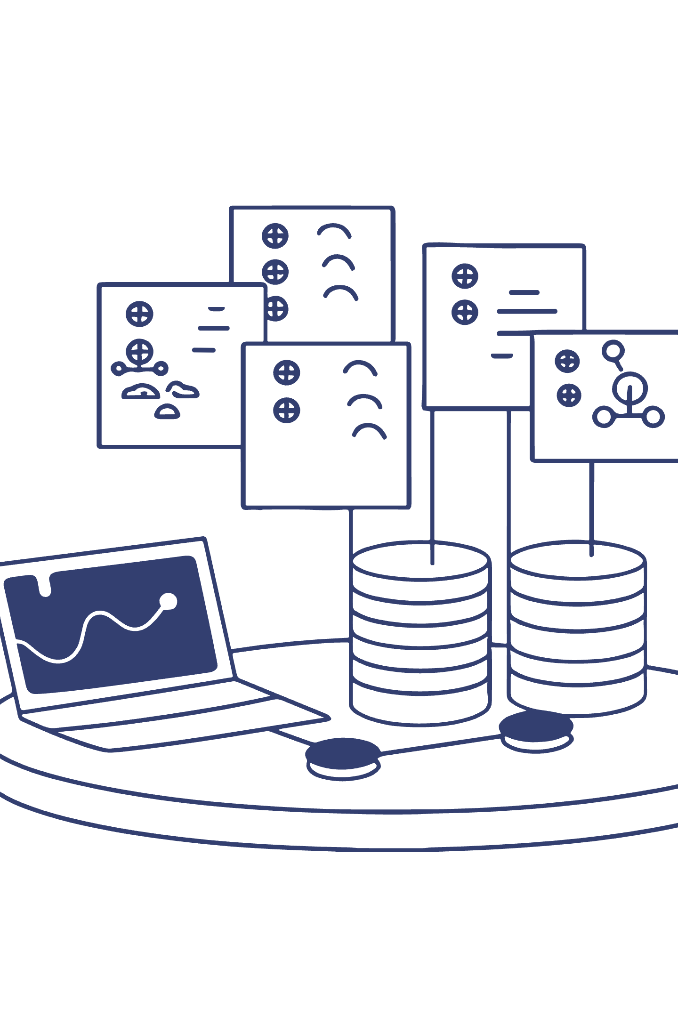
Phase 5: The Modern Toolkit
Using AI Responsibly
Do:
Use AI for brainstorming keywords, summarizing long papers, and exploring different perspectives.
Don't:
Use AI to write your speeches or final content. Always verify information and cross-reference with cited sources.

Slide 9
MASTERING STRATEGIC RESEARCH
THE ADVANCED
A methodical pathway from foundational strategy to advanced analysis and content advocacy.

Slide 10

MUN Committee Global Issue Analysis
PESTLE
SWOT
Political
Strength
Economic
Weakness
Social
Opportunities
Technological
Threats
Legal
Environmental
How governments behave: What are leaders doing? Are countries friends or fighting?
Rules of the game: What laws are in place from countries or groups like the UN?
Political drama: Are there conflicts or arguments between countries?
Money matters: Is the world economy doing well? Are countries rich or poor?
Fairness in money: Is there a big difference in wealth between countries?
Where the money goes: How is money being spent on aid or development?
People power: What do regular people think about the problem? Are they angry or supportive?
Culture & beliefs: Do traditions or different ways of life affect the issue?
Moving people: Are people having to move from their homes, or are populations changing?
New tools: What new technologies can help solve the problem? (Like apps or new ways to make energy)
Bad tools: How are bad guys using technology to cause problems? (Like hacking or spreading fake news)
Digital divide: Do some people have access to technology while others don't?
Big agreements: Are there global laws or treaties that everyone has agreed to?
Local laws: How do a country's own laws affect the issue? (Lex Loci)
Legal fights: Are countries arguing over who is in charge of a legal problem?
Nature's changes: How is climate change or pollution affecting the problem?
Using resources: Are we running out of water or other important resources?
Nature's fury: Are natural disasters making the problem worse?
What we have going for us:
Ready-to-go groups like the UN and WHO.
Amazing technology that can help.
People around the world who care and are talking about it.
What's holding us back:
Countries don't want others telling them what to do.
No one can force a country to follow the rules.
Not enough money or people to get the job done.
Political arguments and bias get in the way.
Good chances we can take:
New diplomatic talks could start.
New technology could create a breakthrough solution.
People are more active and want to help.
New ways of doing business could lead to a solution.
Risks we need to watch out for:
Political chaos in a country.
A worldwide money problem (like a recession).New diseases or global security risks.
Worsening environmental disasters.

Slide 11
MUN Committee Global Issue Analysis
PESTLE
SWOT
Political
Strength
Economic
Weakness
Social
Opportunities
Technological
Threats
Legal
Environmental
How governments behave: What are leaders doing? Are countries friends or fighting?
Rules of the game: What laws are in place from countries or groups like the UN?
Political drama: Are there conflicts or arguments between countries?
Money matters: Is the world economy doing well? Are countries rich or poor?
Fairness in money: Is there a big difference in wealth between countries?
Where the money goes: How is money being spent on aid or development?
People power: What do regular people think about the problem? Are they angry or supportive?
Culture & beliefs: Do traditions or different ways of life affect the issue?
Moving people: Are people having to move from their homes, or are populations changing?
New tools: What new technologies can help solve the problem? (Like apps or new ways to make energy)
Bad tools: How are bad guys using technology to cause problems? (Like hacking or spreading fake news)
Digital divide: Do some people have access to technology while others don't?
Big agreements: Are there global laws or treaties that everyone has agreed to?
Local laws: How do a country's own laws affect the issue? (Lex Loci)
Legal fights: Are countries arguing over who is in charge of a legal problem?
Nature's changes: How is climate change or pollution affecting the problem?
Using resources: Are we running out of water or other important resources?
Nature's fury: Are natural disasters making the problem worse?
What we have going for us:
Ready-to-go groups like the UN and WHO.
Amazing technology that can help.
People around the world who care and are talking about it.
What's holding us back:
Countries don't want others telling them what to do.
No one can force a country to follow the rules.
Not enough money or people to get the job done.
Political arguments and bias get in the way.
Good chances we can take:
New diplomatic talks could start.
New technology could create a breakthrough solution.
People are more active and want to help.
New ways of doing business could lead to a solution.
Risks we need to watch out for:
Political chaos in a country.
A worldwide money problem (like a recession).New diseases or global security risks.
Worsening environmental disasters.

Slide 12
MUN Committee Global Issue Analysis
PESTLE
SWOT
Political
Strength
Economic
Weakness
Social
Opportunities
Technological
Threats
Legal
Environmental
How governments behave: What are leaders doing? Are countries friends or fighting?
Rules of the game: What laws are in place from countries or groups like the UN?
Political drama: Are there conflicts or arguments between countries?
Money matters: Is the world economy doing well? Are countries rich or poor?
Fairness in money: Is there a big difference in wealth between countries?
Where the money goes: How is money being spent on aid or development?
People power: What do regular people think about the problem? Are they angry or supportive?
Culture & beliefs: Do traditions or different ways of life affect the issue?
Moving people: Are people having to move from their homes, or are populations changing?
New tools: What new technologies can help solve the problem? (Like apps or new ways to make energy)
Bad tools: How are bad guys using technology to cause problems? (Like hacking or spreading fake news)
Digital divide: Do some people have access to technology while others don't?
Big agreements: Are there global laws or treaties that everyone has agreed to?
Local laws: How do a country's own laws affect the issue? (Lex Loci)
Legal fights: Are countries arguing over who is in charge of a legal problem?
Nature's changes: How is climate change or pollution affecting the problem?
Using resources: Are we running out of water or other important resources?
Nature's fury: Are natural disasters making the problem worse?
What we have going for us:
Ready-to-go groups like the UN and WHO.
Amazing technology that can help.
People around the world who care and are talking about it.
What's holding us back:
Countries don't want others telling them what to do.
No one can force a country to follow the rules.
Not enough money or people to get the job done.
Political arguments and bias get in the way.
Good chances we can take:
New diplomatic talks could start.
New technology could create a breakthrough solution.
People are more active and want to help.
New ways of doing business could lead to a solution.
Risks we need to watch out for:
Political chaos in a country.
A worldwide money problem (like a recession).New diseases or global security risks.
Worsening environmental disasters.

Slide 13
MUN Committee Global Issue Analysis
PESTLE
SWOT
Political
Economic
Social
Technological
Legal
Environmental
How governments behave: What are leaders doing? Are countries friends or fighting?
Rules of the game: What laws are in place from countries or groups like the UN?
Political drama: Are there conflicts or arguments between countries?
Money matters: Is the world economy doing well? Are countries rich or poor?
Fairness in money: Is there a big difference in wealth between countries?
Where the money goes: How is money being spent on aid or development?
People power: What do regular people think about the problem? Are they angry or supportive?
Culture & beliefs: Do traditions or different ways of life affect the issue?
Moving people: Are people having to move from their homes, or are populations changing?
Strength
Weakness
Opportunities
Threats

Slide 14
MUN Committee Global Issue Analysis
PESTLE
SWOT
Political
Economic
Social
Technological
Legal
Environmental
How governments behave: What are leaders doing? Are countries friends or fighting?
Rules of the game: What laws are in place from countries or groups like the UN?
Political drama: Are there conflicts or arguments between countries?
Money matters: Is the world economy doing well? Are countries rich or poor?
Fairness in money: Is there a big difference in wealth between countries?
Where the money goes: How is money being spent on aid or development?
People power: What do regular people think about the problem? Are they angry or supportive?
Culture & beliefs: Do traditions or different ways of life affect the issue?
Moving people: Are people having to move from their homes, or are populations changing?
New tools: What new technologies can help solve the problem? (Like apps or new ways to make energy)
Bad tools: How are bad guys using technology to cause problems? (Like hacking or spreading fake news)
Digital divide: Do some people have access to technology while others don't?
Big agreements: Are there global laws or treaties that everyone has agreed to?
Local laws: How do a country's own laws affect the issue? (Lex Loci)
Legal fights: Are countries arguing over who is in charge of a legal problem?
Nature's changes: How is climate change or pollution affecting the problem?
Using resources: Are we running out of water or other important resources?
Nature's fury: Are natural disasters making the problem worse?
Strength
Weakness
Opportunities
Threats

Slide 15
MUN Committee Global Issue Analysis
PESTLE
SWOT
Political
Strength
Economic
Weakness
Social
Opportunities
Technological
Threats
Legal
Environmental
How governments behave: What are leaders doing? Are countries friends or fighting?
Rules of the game: What laws are in place from countries or groups like the UN?
Political drama: Are there conflicts or arguments between countries?
Money matters: Is the world economy doing well? Are countries rich or poor?
Fairness in money: Is there a big difference in wealth between countries?
Where the money goes: How is money being spent on aid or development?
People power: What do regular people think about the problem? Are they angry or supportive?
Culture & beliefs: Do traditions or different ways of life affect the issue?
Moving people: Are people having to move from their homes, or are populations changing?
New tools: What new technologies can help solve the problem? (Like apps or new ways to make energy)
Bad tools: How are bad guys using technology to cause problems? (Like hacking or spreading fake news)
Digital divide: Do some people have access to technology while others don't?
Big agreements: Are there global laws or treaties that everyone has agreed to?
Local laws: How do a country's own laws affect the issue? (Lex Loci)
Legal fights: Are countries arguing over who is in charge of a legal problem?
Nature's changes: How is climate change or pollution affecting the problem?
Using resources: Are we running out of water or other important resources?
Nature's fury: Are natural disasters making the problem worse?
What we have going for us:
Ready-to-go groups like the UN and WHO.
Amazing technology that can help.
People around the world who care and are talking about it.
What's holding us back:
Countries don't want others telling them what to do.
No one can force a country to follow the rules.
Not enough money or people to get the job done.
Political arguments and bias get in the way.
Good chances we can take:
New diplomatic talks could start.
New technology could create a breakthrough solution.
People are more active and want to help.
New ways of doing business could lead to a solution.
Risks we need to watch out for:
Political chaos in a country.
A worldwide money problem (like a recession).New diseases or global security risks.
Worsening environmental disasters.

Slide 16
MUN Committee Global Issue Analysis
PESTLE
SWOT
Political
Economic
Social
Technological
Legal
Environmental
How governments behave: What are leaders doing? Are countries friends or fighting?
Rules of the game: What laws are in place from countries or groups like the UN?
Political drama: Are there conflicts or arguments between countries?
Money matters: Is the world economy doing well? Are countries rich or poor?
Fairness in money: Is there a big difference in wealth between countries?
Where the money goes: How is money being spent on aid or development?
People power: What do regular people think about the problem? Are they angry or supportive?
Culture & beliefs: Do traditions or different ways of life affect the issue?
Moving people: Are people having to move from their homes, or are populations changing?
New tools: What new technologies can help solve the problem? (Like apps or new ways to make energy)
Bad tools: How are bad guys using technology to cause problems? (Like hacking or spreading fake news)
Digital divide: Do some people have access to technology while others don't?
Big agreements: Are there global laws or treaties that everyone has agreed to?
Local laws: How do a country's own laws affect the issue? (Lex Loci)
Legal fights: Are countries arguing over who is in charge of a legal problem?
Nature's changes: How is climate change or pollution affecting the problem?
Using resources: Are we running out of water or other important resources?
Nature's fury: Are natural disasters making the problem worse?
Strength
Weakness
Opportunities
Threats
What we have going for us:
Ready-to-go groups like the UN and WHO.
Amazing technology that can help.
People around the world who care and are talking about it.
What's holding us back:
Countries don't want others telling them what to do.
No one can force a country to follow the rules.
Not enough money or people to get the job done.
Political arguments and bias get in the way.

Slide 17
MUN Committee Global Issue Analysis
PESTLE
SWOT
Political
Economic
Social
Technological
Legal
Environmental
How governments behave: What are leaders doing? Are countries friends or fighting?
Rules of the game: What laws are in place from countries or groups like the UN?
Political drama: Are there conflicts or arguments between countries?
Money matters: Is the world economy doing well? Are countries rich or poor?
Fairness in money: Is there a big difference in wealth between countries?
Where the money goes: How is money being spent on aid or development?
People power: What do regular people think about the problem? Are they angry or supportive?
Culture & beliefs: Do traditions or different ways of life affect the issue?
Moving people: Are people having to move from their homes, or are populations changing?
New tools: What new technologies can help solve the problem? (Like apps or new ways to make energy)
Bad tools: How are bad guys using technology to cause problems? (Like hacking or spreading fake news)
Digital divide: Do some people have access to technology while others don't?
Big agreements: Are there global laws or treaties that everyone has agreed to?
Local laws: How do a country's own laws affect the issue? (Lex Loci)
Legal fights: Are countries arguing over who is in charge of a legal problem?
Nature's changes: How is climate change or pollution affecting the problem?
Using resources: Are we running out of water or other important resources?
Nature's fury: Are natural disasters making the problem worse?
Strength
Weakness
Opportunities
Threats
What we have going for us:
Ready-to-go groups like the UN and WHO.
Amazing technology that can help.
People around the world who care and are talking about it.
What's holding us back:
Countries don't want others telling them what to do.
No one can force a country to follow the rules.
Not enough money or people to get the job done.
Political arguments and bias get in the way.
Good chances we can take:
New diplomatic talks could start.
New technology could create a breakthrough solution.
People are more active and want to help.
New ways of doing business could lead to a solution.
Risks we need to watch out for:
Political chaos in a country.
A worldwide money problem (like a recession).New diseases or global security risks.
Worsening environmental disasters.

Slide 18
THANK YOU

